Slide 1

Welcome to
Software Engineering (IT314)
Lab 8
UML Diagrams
Kalgi Gandhi, Aman Sinha
Course Instructor: Prof. Jayprakash Lalchandani
DA-IICT

Slide 2
Outline
UML Diagrams
Types of UML Diagrams
Behavioral Diagrams
State Machine Diagram
Communication Diagram
Use Case Diagram
Activity Diagram
Sequence Diagram
Timing Diagram
Interaction Overview Diagram
Election management system: An example
VP Tool Demo

Slide 3
UML Diagrams
UML stands for Unified Modeling Language
It’s a rich language to model software solutions, application structures, system behavior and business processes
These diagrams are further classified as:
Structure Diagrams
Behavioral Diagrams

Slide 4
Types of UML Diagrams I
Structure Diagrams
Structure diagrams show the things in the modeled system
In a more technical term, it shows different objects in a system
Behavioral Diagrams
Behavioral diagrams show what should happen in a system
It describe how the objects interact with each other to create a functioning system

Slide 5
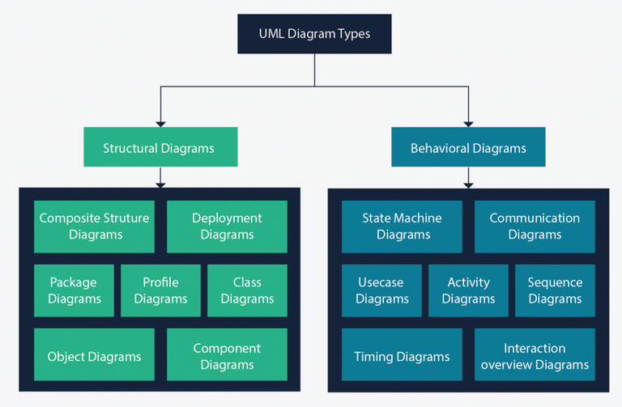
Types of UML Diagrams II

Slide 6
Behavioral Diagrams: Why to Study these???
The objective of behavior modeling is to study/specify the behavior of the objects in a system
At the logical level, the behavioral models allow us to:
Complete the structural model by finding the methods of our classes
Validate the structural model by making sure that all required attributes and associations are present
At the physical level:
Sequence and Activity diagrams define a specification for our algorithms
State Machines can be used to generate executable code

Slide 7
Sequence Diagrams

Slide 8
Sequence Diagram
Sequence diagram are also called as Event diagram or an Event scenario
These are used to represent the order in which objects interact and how they interact, thereby enabling us to represent simple runtime scenarios
This diagram basically represents the sequence of messages flowing from one object to another
Importance of sequence diagram stems from the fact that interaction among the components of a system is very important for implementation and execution perspective
Sequence diagram can be used to visualize the sequence of calls in a system to perform a specific task
It is important to note that represents just an instance of a possible interaction and is not an exhaustive representation of the system’s behavior
In a sequence diagram processes are represented vertically and interactions among them are shown using arrows

Slide 9
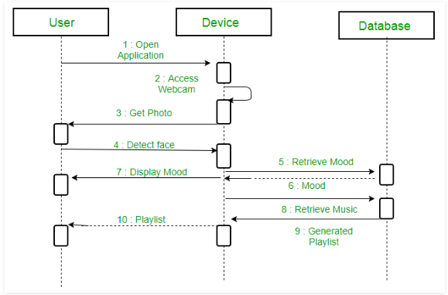
Sequence Diagram
There are two axes in a sequence diagram:
The horizontal axis has the objects
The vertical axis represents the progressing time, in the context of execution order

Slide 10



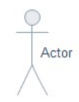
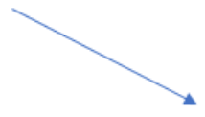



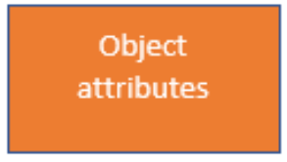

Sequence Diagram: Important Symbols
To be represented | Symbol
Lifeline
Actor
Activity
State
Object flow
To be represented | Symbol
Bars
Initial State
Control Flow
Decision Activity
Objects

Slide 11




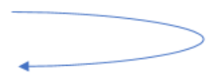

Sequence Diagram: Important Symbols
To be represented | Symbol
Package
Synchronous message
Asynchronous message
To be represented | Symbol
Create message
Delete message
Self message

Slide 12
Sequence Diagram: Important Concepts
Objects:
Objects are the classes instances that participate in the interaction
Objects have lifeline
Actors:
An actor in a UML diagram represents a type of role where it interacts with the system and its objects
An actor is always outside the scope of the system we aim to model
Lifelines:
A lifeline is a named element which depicts an individual participant in a sequence diagram
Each instance in a sequence diagram is represented by a lifeline
Lifeline elements are located at the top in a sequence diagram
Difference between lifeline and actor:
A lifeline always portrays an object internal to the system whereas actors are used to depict objects external to the system

Slide 13
Sequence Diagram: Important Concepts
Messages:
Communication between objects is depicted using messages
The messages appear in a sequential order on the lifeline
Lifelines and messages form the core of a sequence diagram
Types of messages:
Synchronous messages: A synchronous message waits for a reply before the interaction can move forward
Asynchronous messages: An asynchronous message does not wait for a reply from the receiver
Create message: We use a Create message to instantiate a new object in the sequence diagram
Delete message: We use a Delete Message to delete an object
Self message: Certain scenarios might arise where the object needs to send a message to itself. Such messages are called Self Messages
Reply message: Reply messages are used to show the message being sent from the receiver to the sender
Found message: A Found message is used to represent a scenario where an unknown source sends the message
Lost message: A Lost message is used to represent a scenario where the recipient is not known to the system

Slide 14
Sequence Diagram: Important Concepts
Guards:
Guards are used to model conditions in sequence diagrams
They are used when we need to restrict the flow of messages on the pretext of a condition being met
Guards play an important role in letting software developers know the constraints attached to a system or a particular process

Slide 15
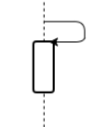
Sequence Diagram: Important Concepts
Activation:
These are also called the method-invocation boxes
Activation elements in the UML sequence diagram are boxes on the lifelines
Indicate that an object is responding to a message
It starts when the message is received and ends when the object is done handling the message
Recursive calls:
A call in which an object calls its own operations
Notation:

Slide 16
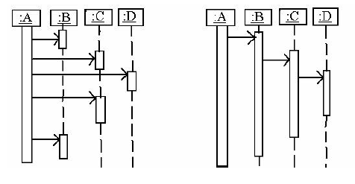
Sequence Diagram: Important Concepts
Control flow types:
Sequence diagrams can be used to easily and visually identify the application’s control flow
Control flow can be centralised or Distributed
Example:

Slide 17
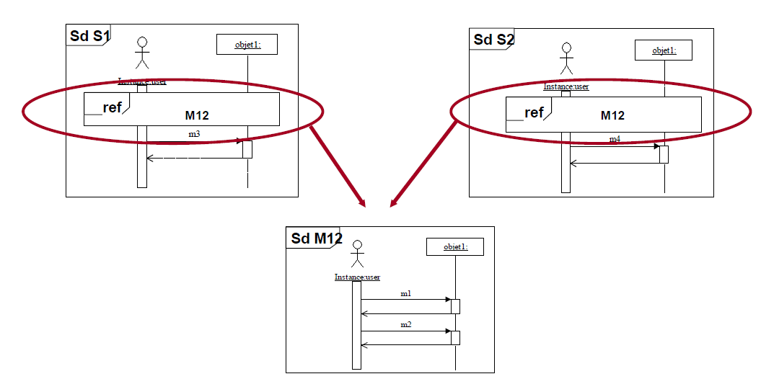
Sequence Diagram: Important Concepts
Fragments:
Fragments are used to represent:
Loops
Conditional branches
References to other sequence diagram, etc

Slide 18
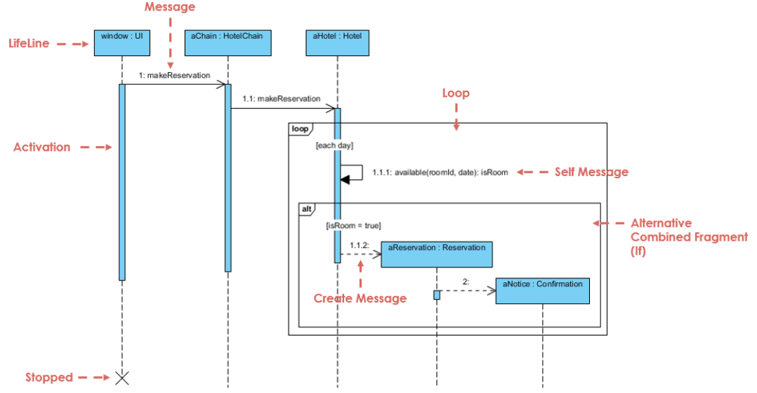
Sequence Diagram: An Example of Hotel Reservation

Slide 19
State Machine Diagrams

Slide 20
State Machine Diagram
State machine diagrams are similar to activity diagrams, although notations and usage change a bit
They are sometimes known as state diagrams or state chart diagrams as well
These are very useful to describe the behavior of objects that act differently according to the state they are in at the moment
The State machine diagram below shows the basic states and actions

Slide 21
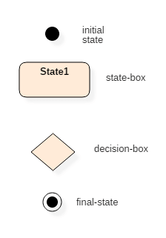
State Machine Diagram: Important Symbols

Slide 22
State Machine Diagram: Important Concepts
State:
A state is a stage of existence during which an object:
Satisfies certain conditions
Executes an activity or
Waits for an event
A state defines how the object reacts to new events

Slide 23
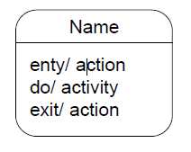
State Machine Diagram: Important Concepts
Representation of state:
A state is described by a rounded rectangle containing:
Name: Must be unique within the class
Entry and Exit actions: Instantaneous processes executed by the object on entering/exiting the state
Activity: Long-lasting processes executed while the object is in that state
Notation:
Final state:
A state diagram can have any number of final states and has no outgoing transitions
The final state signifies that the object has terminated its execution, and has no further reason to exist

Slide 24

State Machine Diagram: Important Concepts
Initial state:
Any state diagram has exactly one initial state
The initial state is the point of creation of the object
The transition leaving it is taken when the object is instantiated
This transition may contain a guard condition and an action, but not an event
It may have multiple mutually-exclusive outgoing transitions, but no incoming transitions
Transition:
A transition describes how an object moves from one state to another
Notation:
The transition is taken when the event is received if the guard condition is true
When the transition is taken, the action is executed by the object
A transition without an event or guard condition is considered to be ‘automatic’

Slide 25
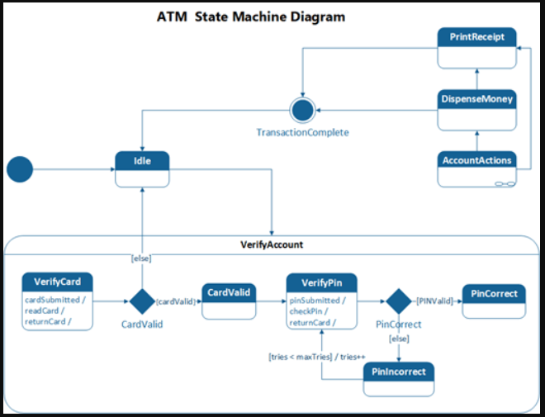
State Machine Diagram: An Example of ATM

Slide 26
Activity Diagrams

Slide 27
Activity Diagram
Activity diagrams are used to describe the flow of control in a system and consist of activities and links
In other words, Activity Diagrams represent workflows in a graphical way and provide an understanding of how the system will work when executed
The flow can be concurrent, sequential, or branched
Activities are nothing but the functions of a system
Many activity diagrams may be needed to capture the entire flow in a system
These can be used to describe both business workflows and workflow of any component in a system
Activity diagrams provide an important feature called as Swimlanes. They are used to represent ‘who is responsible for which activities being performed’
In order to represent swimlanes, we split the Activity diagram into vertical sections, where each section corresponds to one actor

Slide 28
Activity Diagram
Used to model Workflow or Business Processes
Very expressive to model Use Cases
Instead of sequence diagrams for instance
More exhaustive and precise
From UML 2.0, possible to model complex algorithms and operation’s
bodies
Can be attached to:
A class
An operation
A use-case (workflow)

Slide 29
Activity Diagram
Since UML 2.0, we use the notion of action to designate atomic steps in a UML activity diagram (called activities in previous versions)
An activity can be composed of:
Actions
Control Nodes (Fork, Merge, Decision, Join),
Object Nodes (input & output pins, object nodes, activity parameter node)
Arrows (Control Flow & Object Flow)
The execution model of UML AD is based on the notion of production/consumption of token
Largely inspired from Petri Nets
Transitions are automatic
Concurrent flow:
Concurrent flows are used to model activities that can happen in parallel in the system
It is represented as a straight, slightly thicker line in an activity diagram
Fork Node and Join Node are used to represent concurrent flows

Slide 30


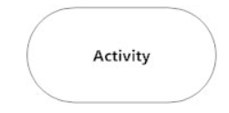



Activity Diagram: Important Symbols
To be represented | Symbol
Initial state
Final state
Activity box
Decision or branching box
Action flow
Action box
Join Node
Fork Node

Slide 31
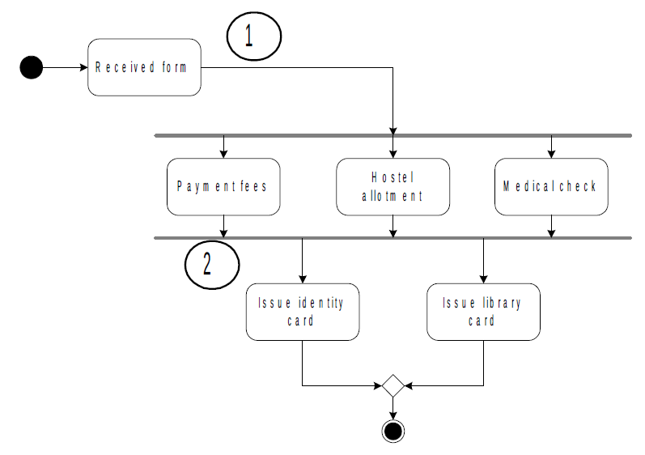
Activity Diagram: An Example of Student Enrollment System

Slide 32
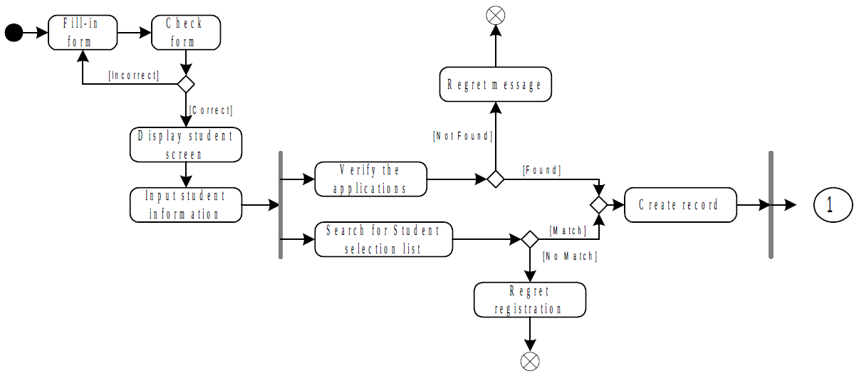
Activity Diagram: An Example of Student Enrollment System

Slide 33
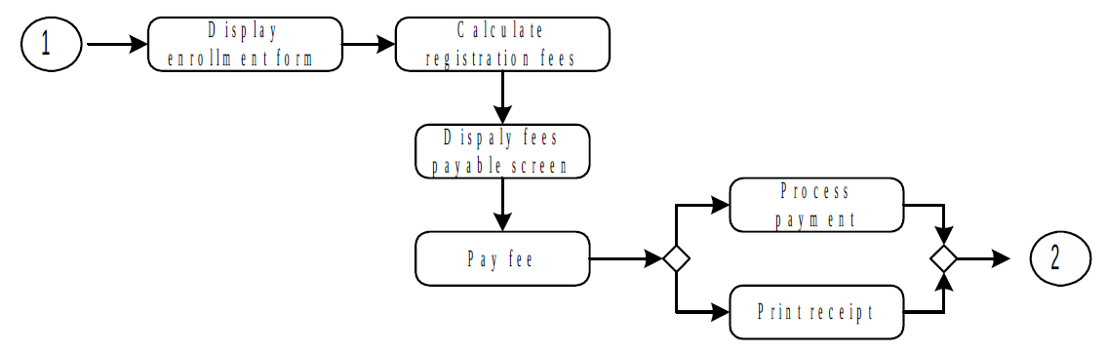
Activity Diagram: An Example of Student Enrollment System

Slide 34
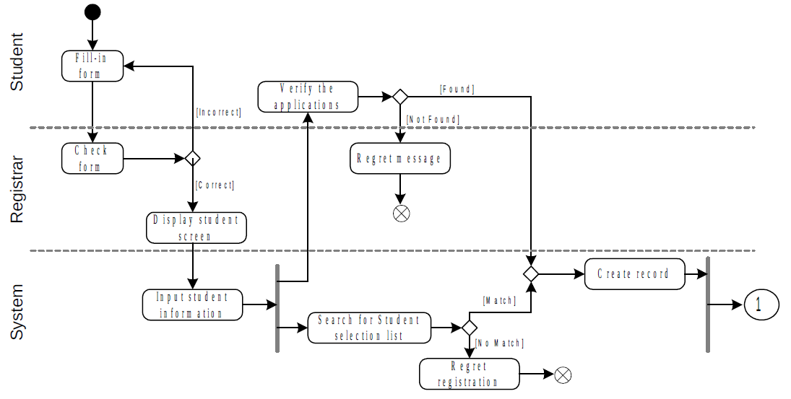
Activity Diagram: An Example of Student Enrollment System

Slide 35
Communication Diagrams

Slide 36
Communication Diagram
Also called collaboration diagrams
Communication diagrams are similar to sequence diagrams, but the focus is on messages passed between objects
The same information can be represented using a sequence diagram and different objects
Why Communication diagram is needed?
Communication diagrams are very useful for visualizing the relationship between objects collaborating to perform a particular task, however, this is difficult to determine from the sequence diagram
Communication diagrams can also help to determine the accuracy of the static model (i.e. class diagram)
Need of timeline in sequence diagram
A sequence diagram is structured in such a way that it represents a timeline which begins at the top and descends gradually to mark the sequence of interactions

Slide 37
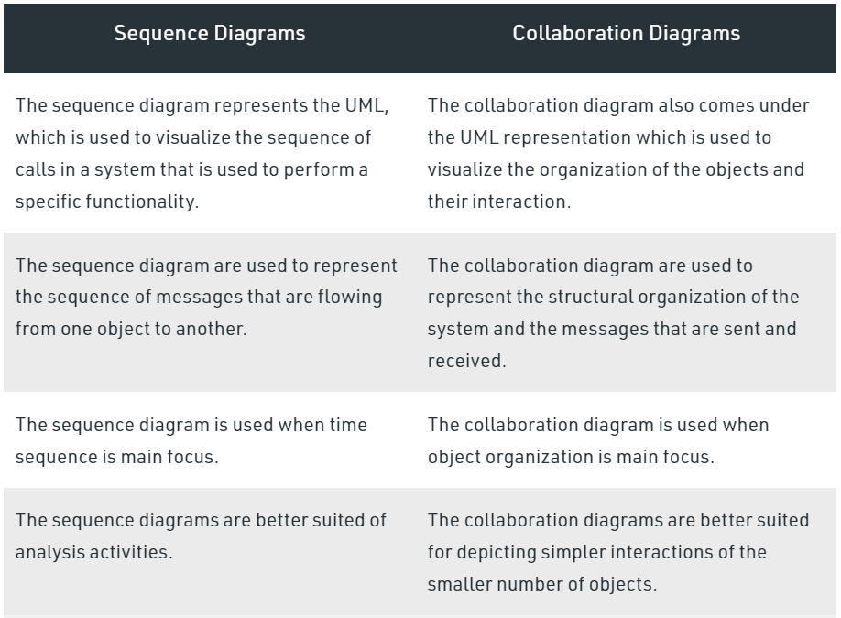
Communication Diagram vs Sequence diagram

Slide 38
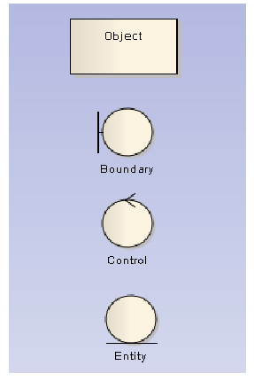
Communication Diagram: Important Symbols

Slide 39
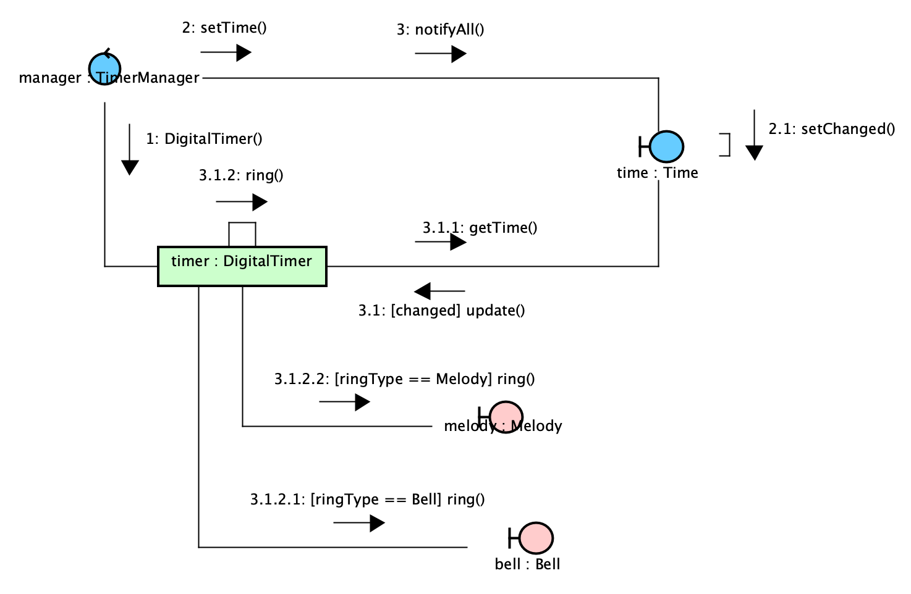
Communication Diagram: An Example of Digital Timer

Slide 40
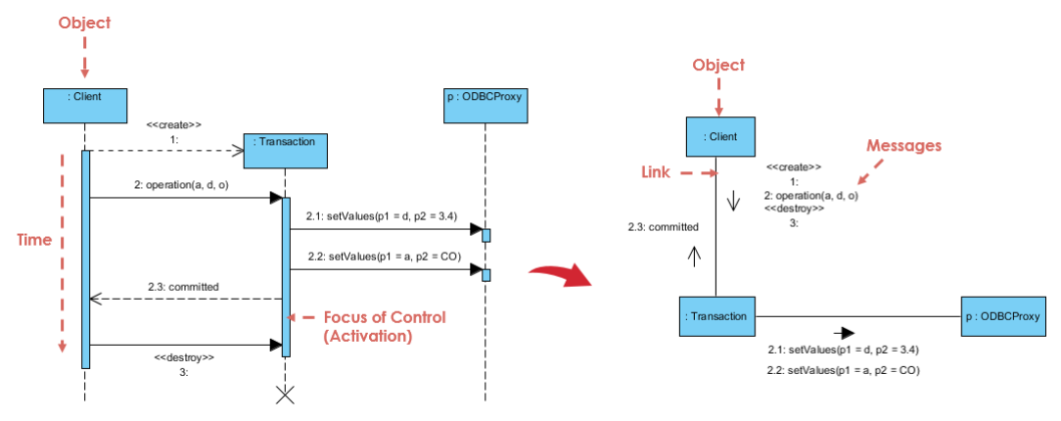
Conversion Between Communication and Sequence Diagram: An Illustrated Example

Slide 41
Use case Diagrams

Slide 42
Use Case Diagram
Use case diagrams give a graphic overview of the actors involved in a system, different functions needed by those actors and how these different functions interact
It’s a great starting point for any project discussion because you can easily identify the main actors involved and the main processes of the system
Can there be multiple Use Case diagrams for a system?
Yes, a system may have multiple use case diagrams
The main purpose of having multiple use case diagrams for a system may be any of the following:
To showcase different viewpoints (ex: business vs system)
To showcase different levels of details
To showcase the different parts or components of a complex system to ensure easy readability and understanding

Slide 43
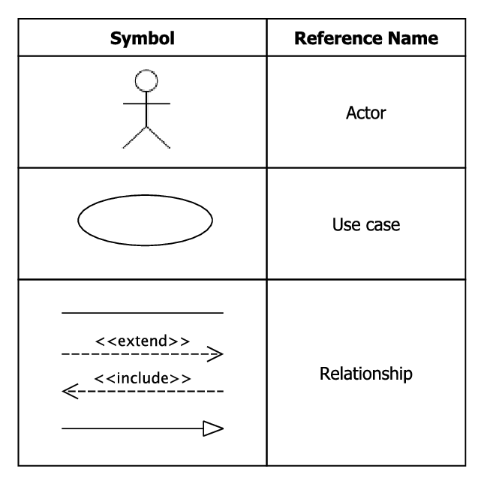
Use Case Diagram: Important Symbols

Slide 44
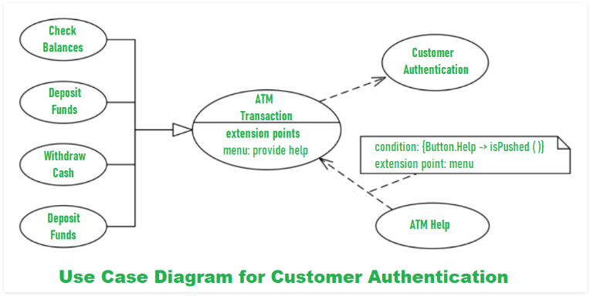
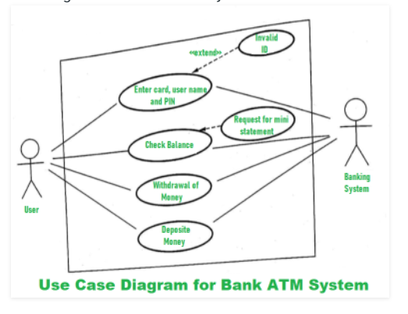
Use Case Diagram: An Example of ATM - 1

Slide 45
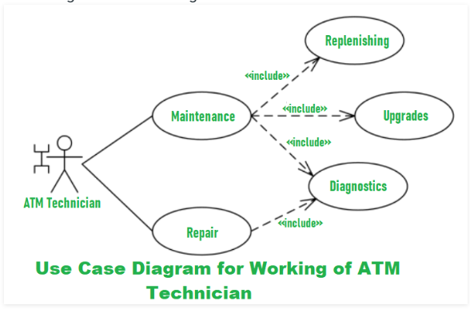
Use Case Diagram: An Example of ATM - 2

Slide 46
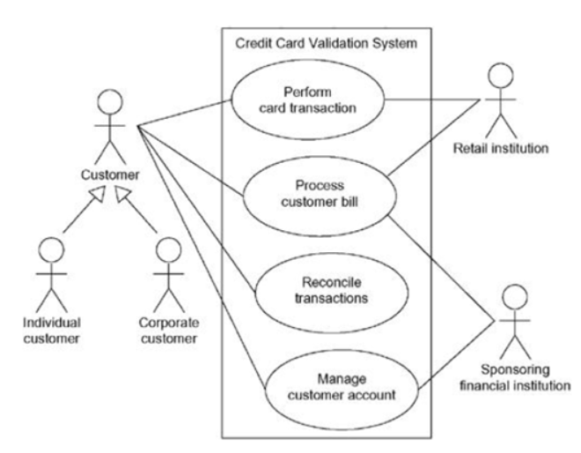
Use Case Diagram: An Example with hierarchy

Slide 47
Timing Diagrams

Slide 48
Timing Diagram
Timing diagrams are used to represent the behavior of objects in a given time frame
Often described as an inverted sequence diagram, a timing diagram shows how objects interact with each other in a given timeframe
Timing diagrams may be used to see how long each step of a process takes and find areas for improvement

Slide 49
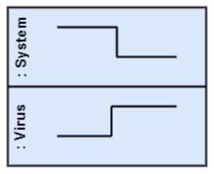
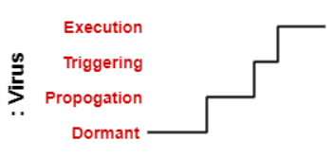
Timing Diagram: Basic concepts
Lifeline: It represents a single entity, which is a part of the interaction. Ex: Following lifeline represents instances of a System and Virus:
State or condition timeline: represents the state of a classifier or attributes that are participating, or some testable conditions, which is a discrete value of the classifier. Ex: Following timeline shows the change in the state of virus:

Slide 50
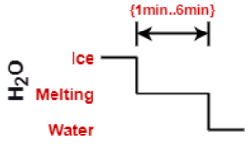

Timing Diagram: Basic concepts
Duration constraint: Duration constraint is a constraint of an interval, which refers to duration interval. It is used to determine if the constraint is satisfied for a duration or not. Ex: Following demonstrates the duration constraint ‘Ice should melt into the water in 1 to 6 minutes’:
Time constraint: It is an interval constraint, which refers to the time interval. As it is a time expression, it depicts if the constraint is satisfied or not. Ex: Following demonstrates the time constraint ‘A person should wakeup in between 5:40 AM and 6:00 AM:

Slide 51
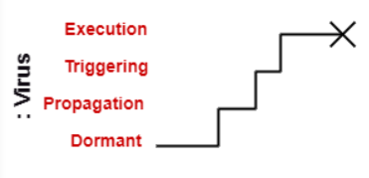
Timing Diagram: Basic concepts
Destruction occurrence: The destruction occurrence refers to the occurrence of a message that represents the destruction of an instance is defined by a lifeline. It is represented by a cross at the end of a timeline. Ex: Following demonstrates the destruction occurrence ‘Virus lifeline is terminated’:

Slide 52
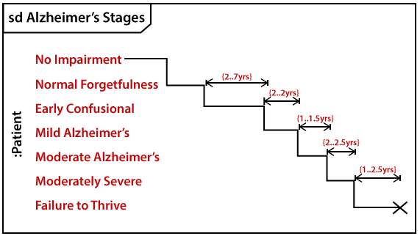
Timing Diagram: An Example of Alzheimer's Stages

Slide 53
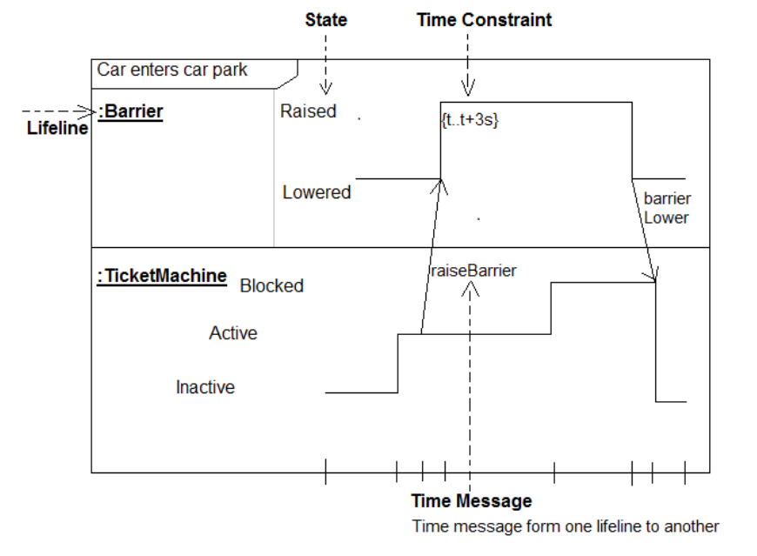
Timing Diagram: An Example of Car Parking

Slide 54
Interaction overview Diagrams

Slide 55
Interaction Overview Diagram
Interaction overview diagrams provide a high level of abstraction of an interaction model
It is a variant of the Activity Diagram
It focuses on the overview of the flow of control of the interactions
It can picture a control flow with nodes that can contain interaction diagrams which show how a set of fragments might be initiated in various scenarios
Interaction overview diagrams focus on the overview of the flow of control where the nodes are interactions (sd) or interaction use (ref)
The other notation elements for interaction overview diagrams are the same as for activity and sequence diagrams. These include initial, final, decision, merge, fork and join nodes

Slide 56
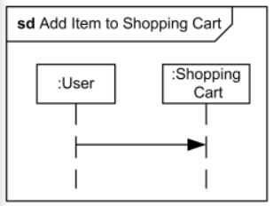

Interaction Overview Diagram: Notations used
Interaction: An interaction diagram of any kind may appear inline as an invocation action. The inline interaction diagrams may be either anonymous or named. Ex: Interaction Add Item to Shopping Cart may appear inline on some interaction overview diagram
Interaction Use: An interaction use may appear as an invocation action. Ex: Interaction use Add Item to Shopping Cart may appear on some interaction overview diagram

Slide 57
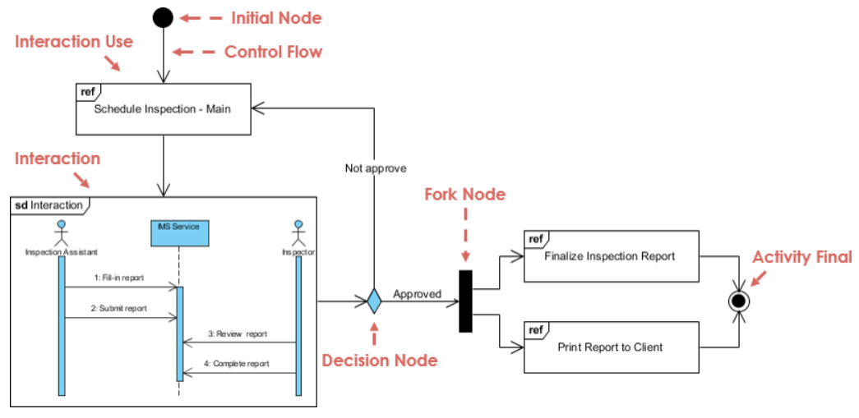
Interaction Overview Diagram: An Example of Scheduling System

Slide 58
Election Management System: An example

Slide 59
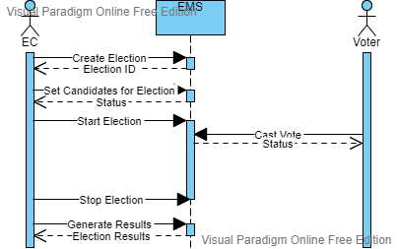
Sequence Diagram: An Example of Election Management System

Slide 60
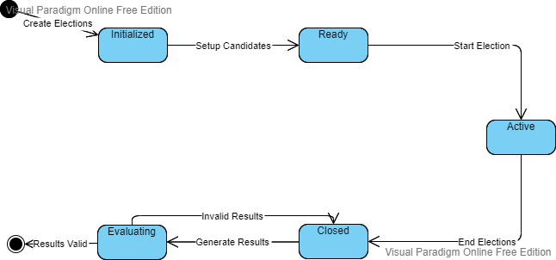
State Machine Diagram: An Example of Election Management System

Slide 61
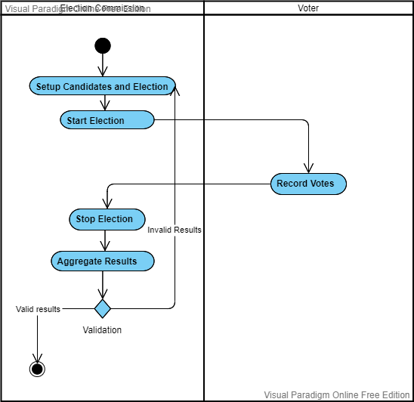
Activity Diagram: An Example of Election Management System

Slide 62
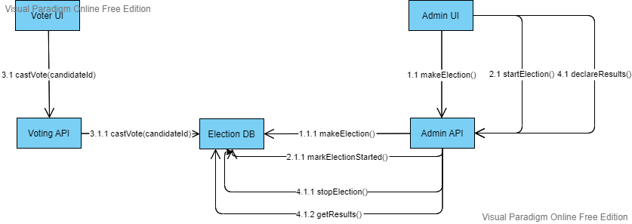
Communication Diagram: An Example of Election Management System

Slide 63
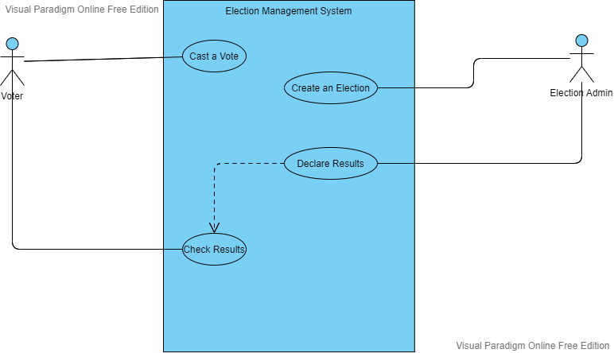
Use Case Diagram: An Example of Election Management System

Slide 64
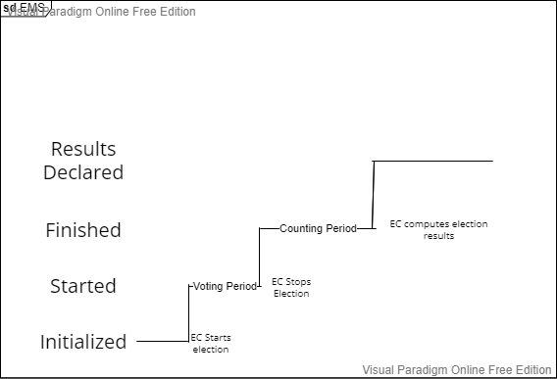
Timing Diagram: An Example of Election Management System

Slide 65
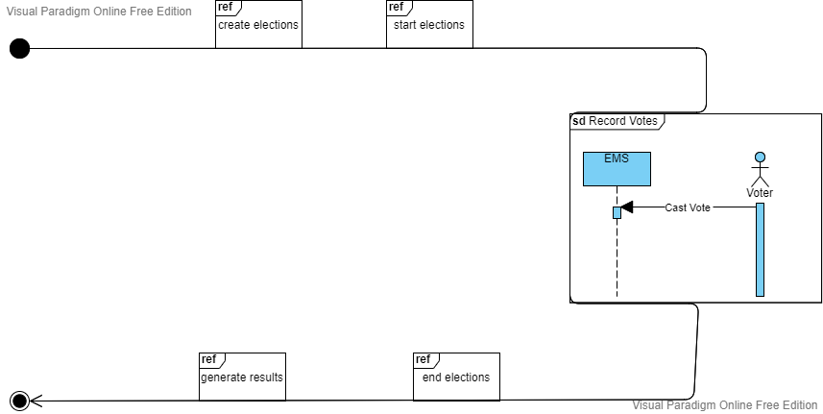
Interaction Overview Diagram: An Example of Election Management System

Slide 66
VP Tool Demo

Slide 67

Home Page

Slide 68
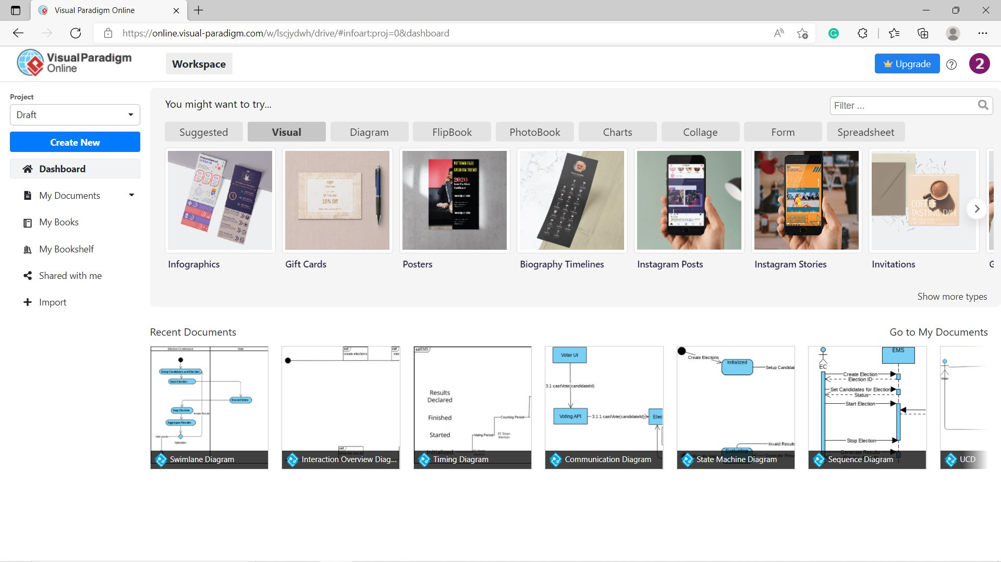
Dashboard

Slide 69

Signup

Slide 70
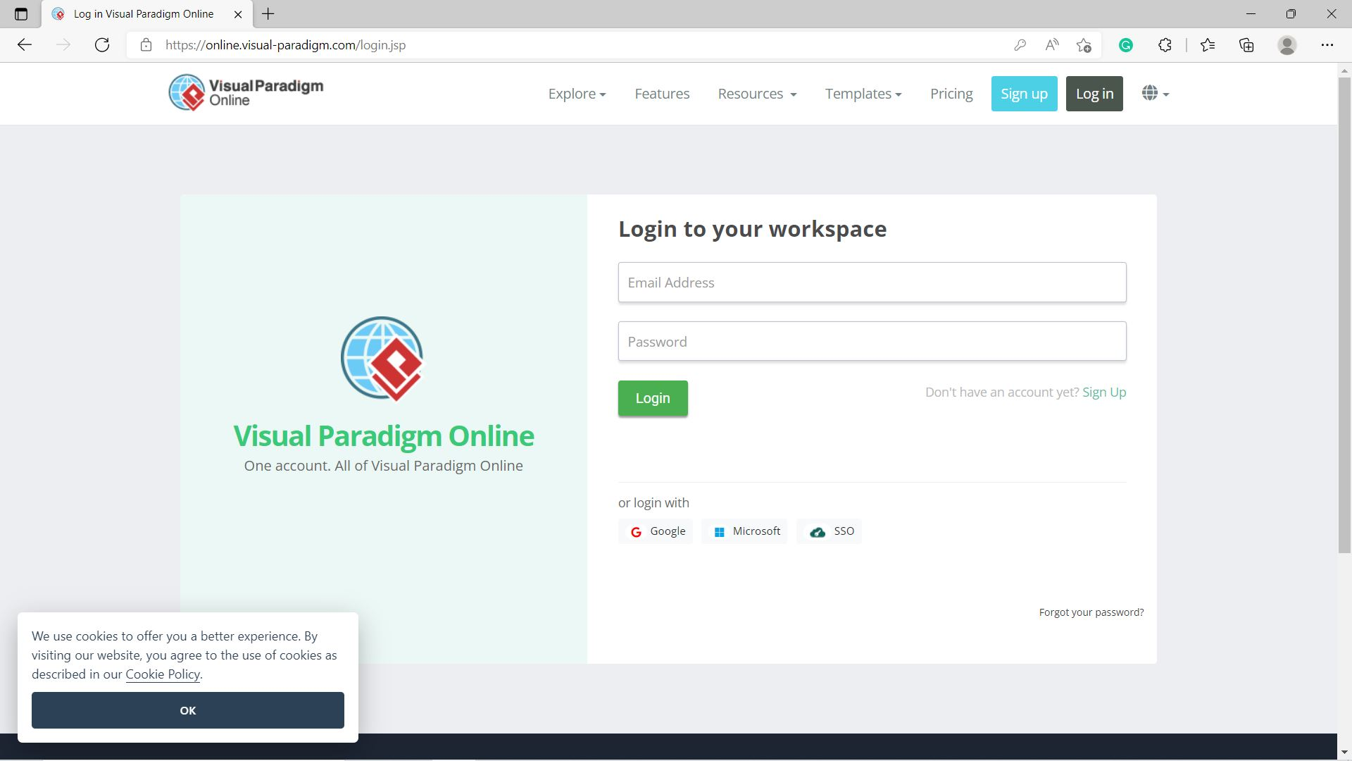
Login

Slide 71
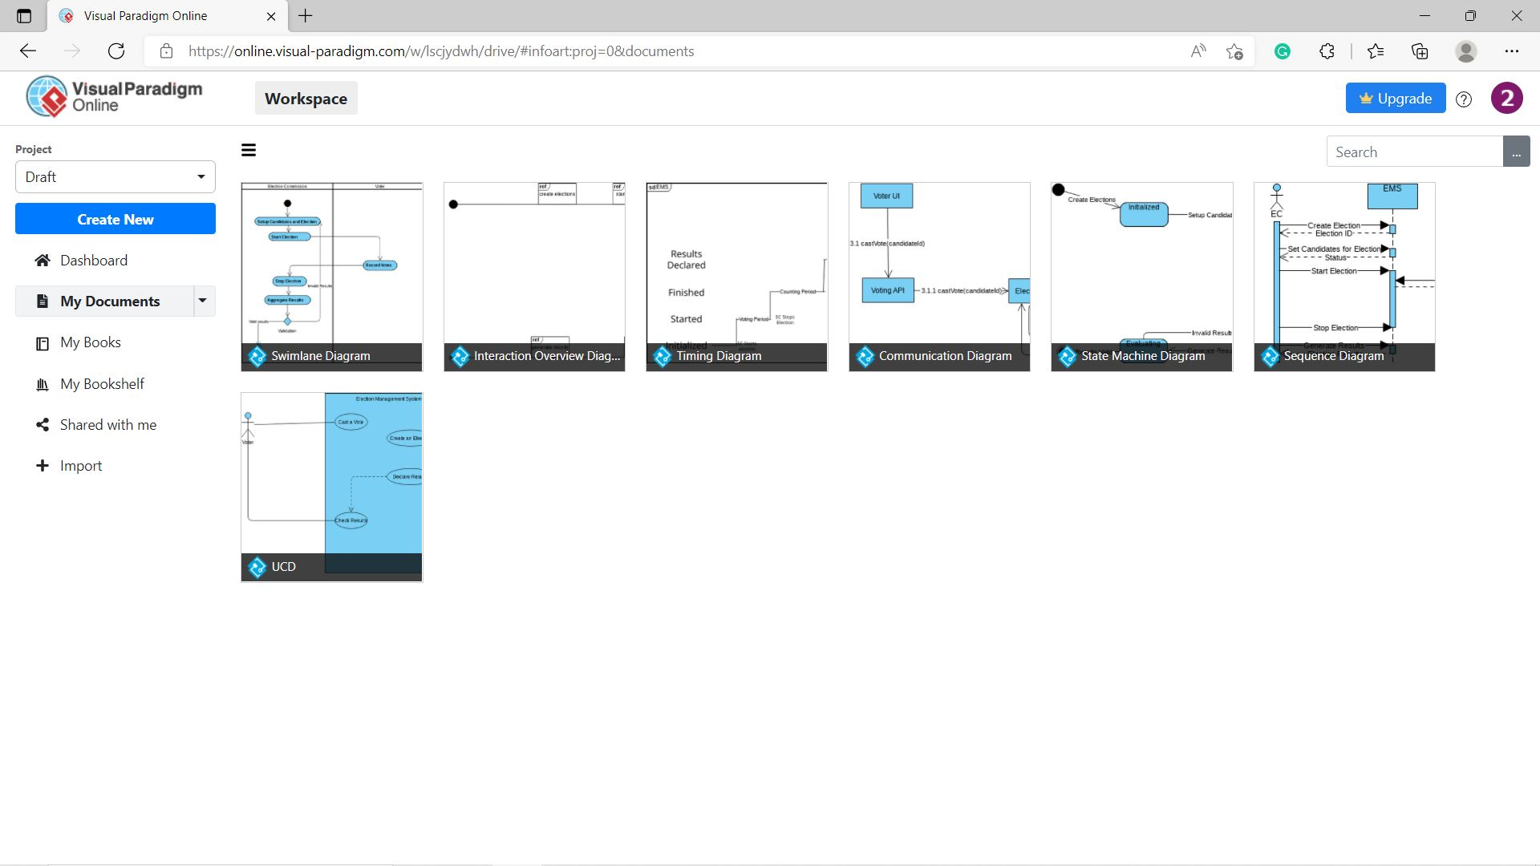
My Documents

Slide 72
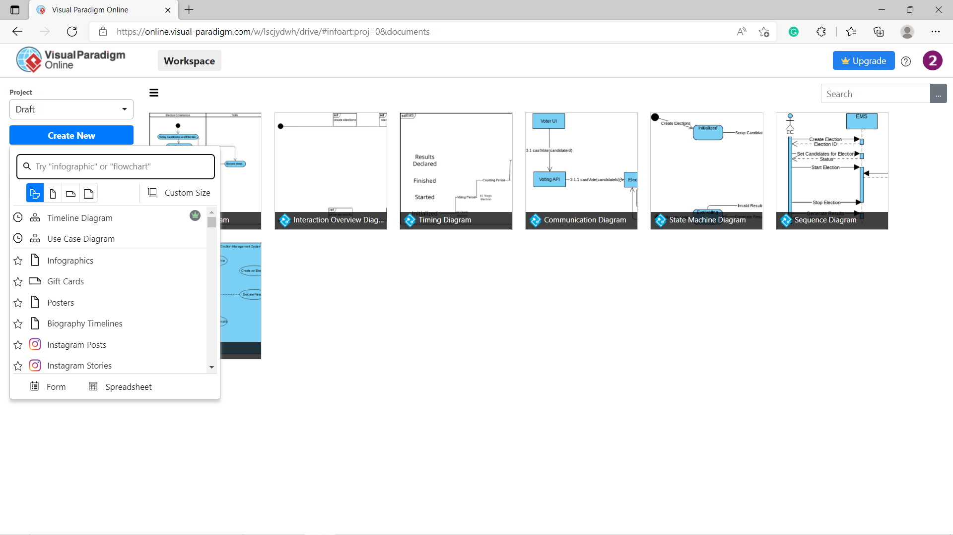
Add New

Slide 73
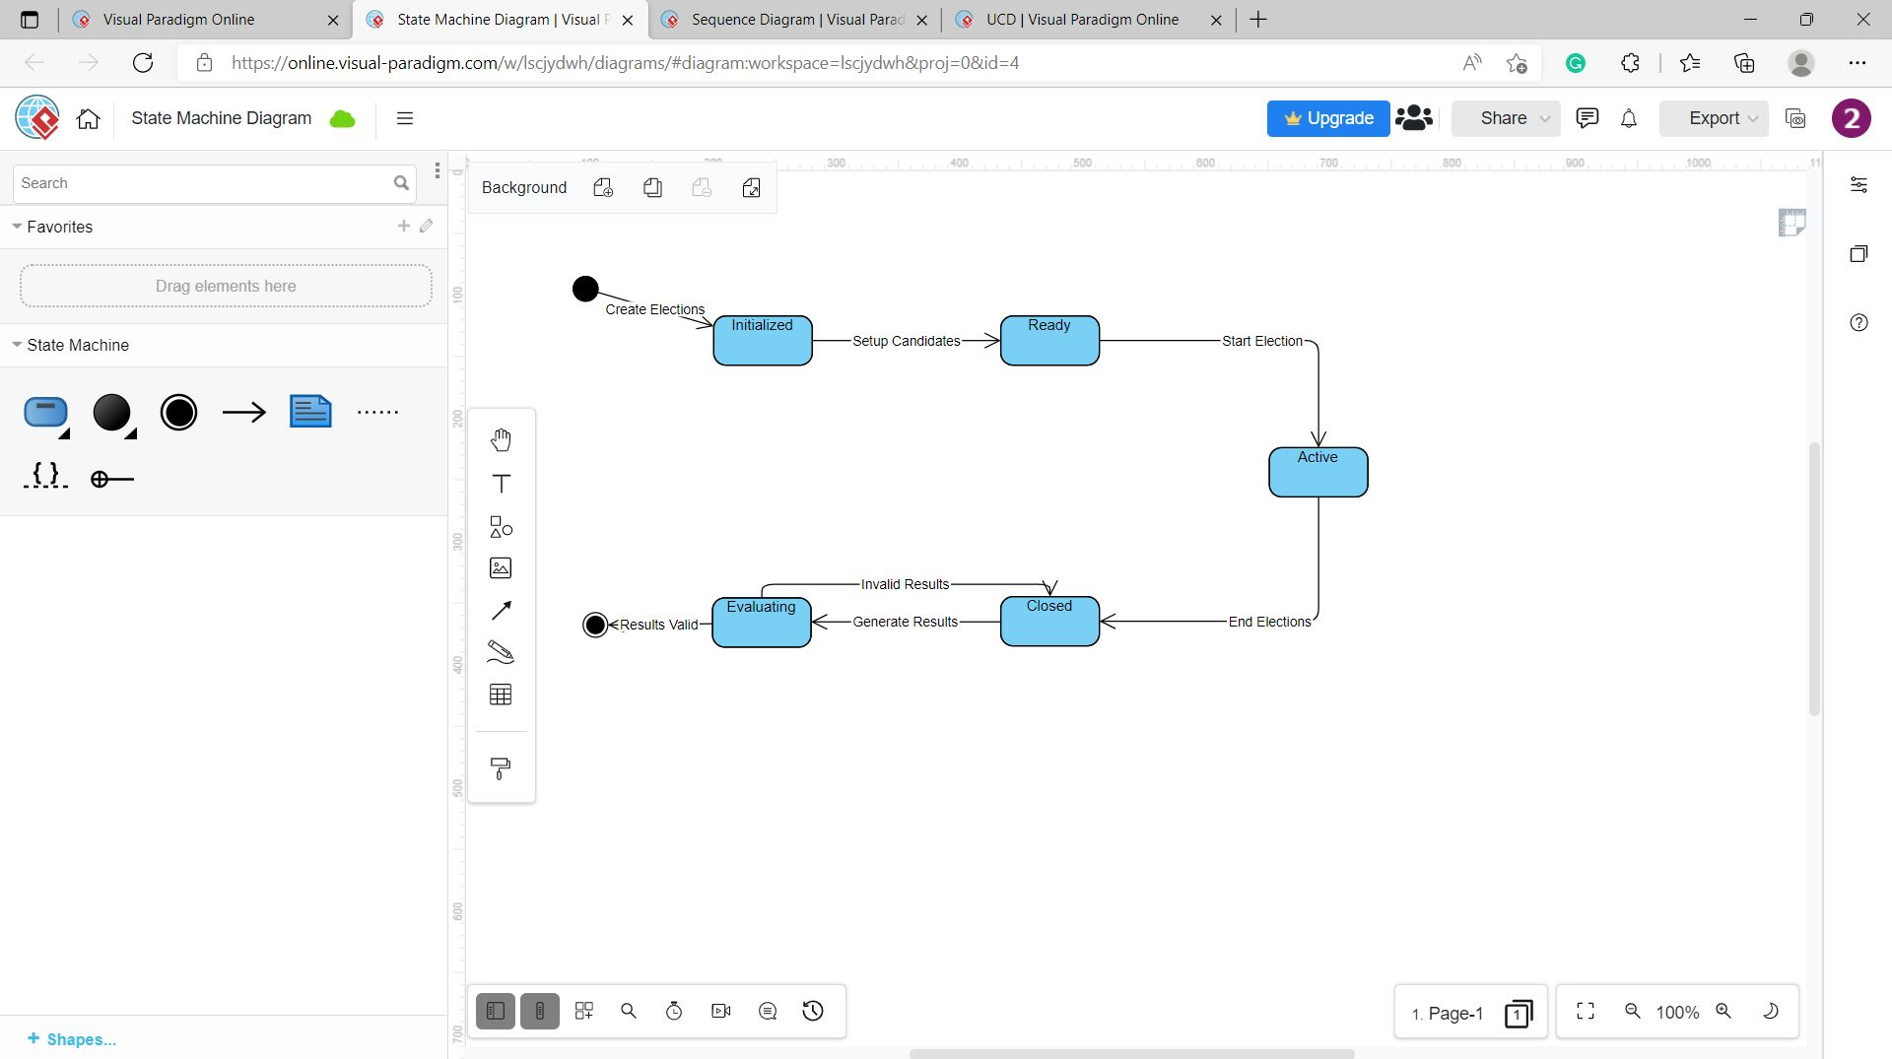
State Machine Diagram

Slide 74
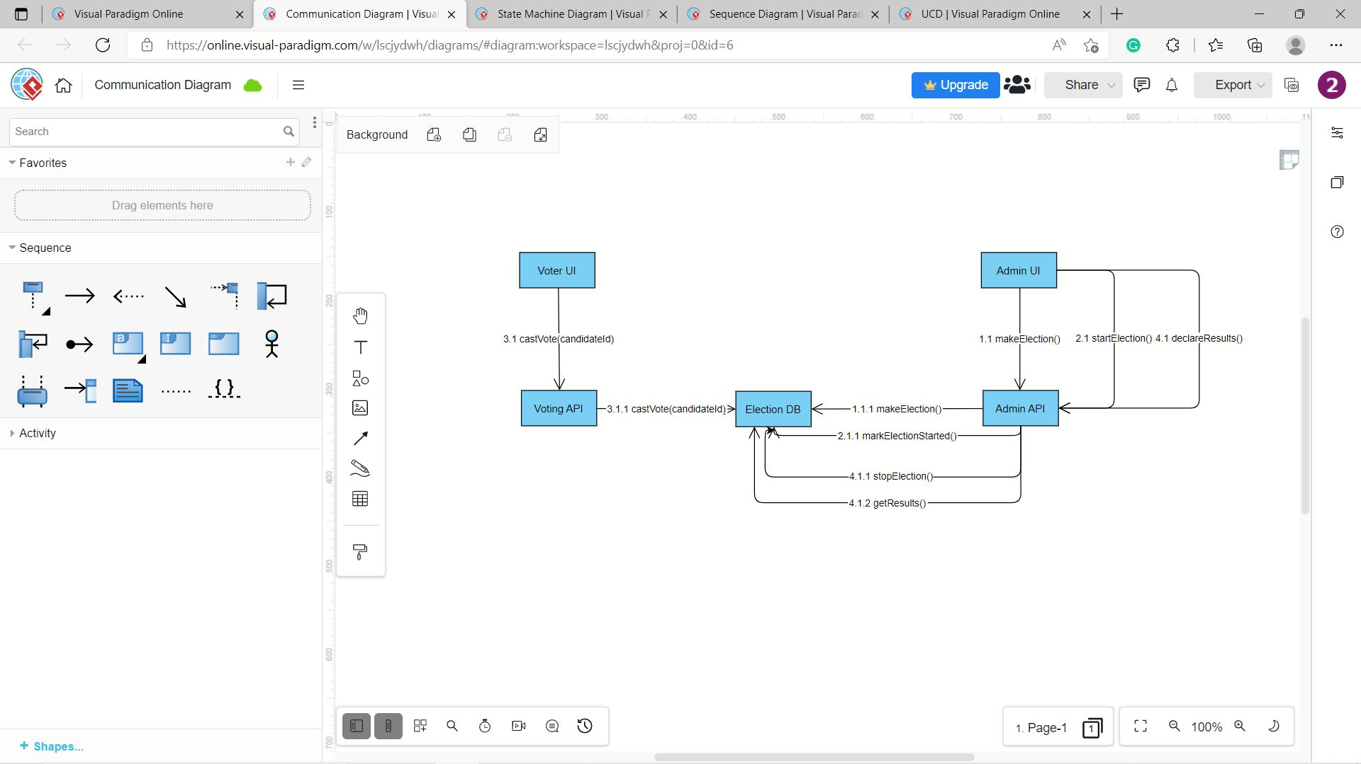
Communication Diagram

Slide 75
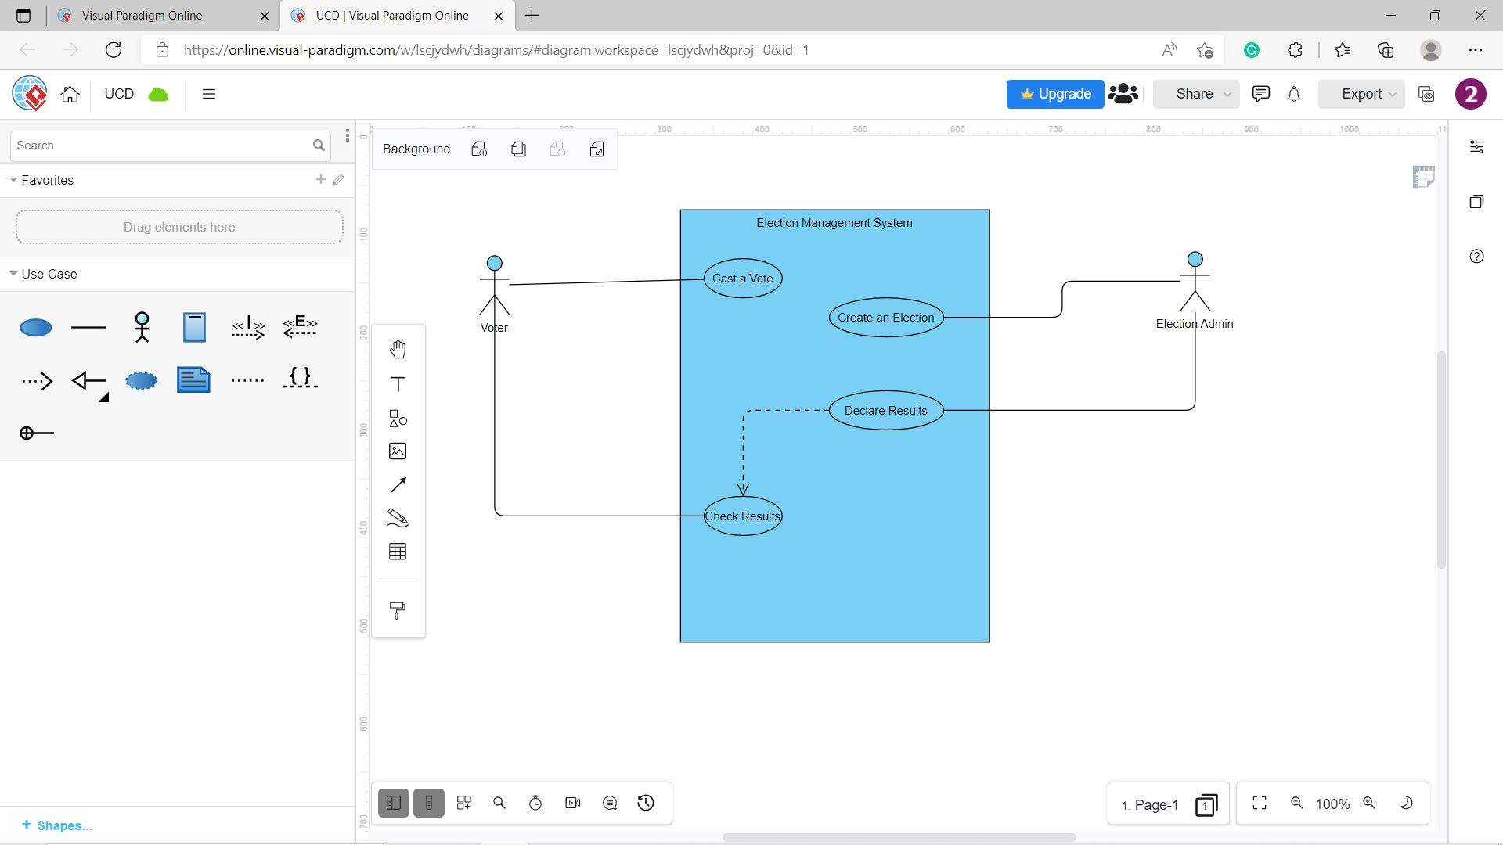
Use Case Diagram

Slide 76
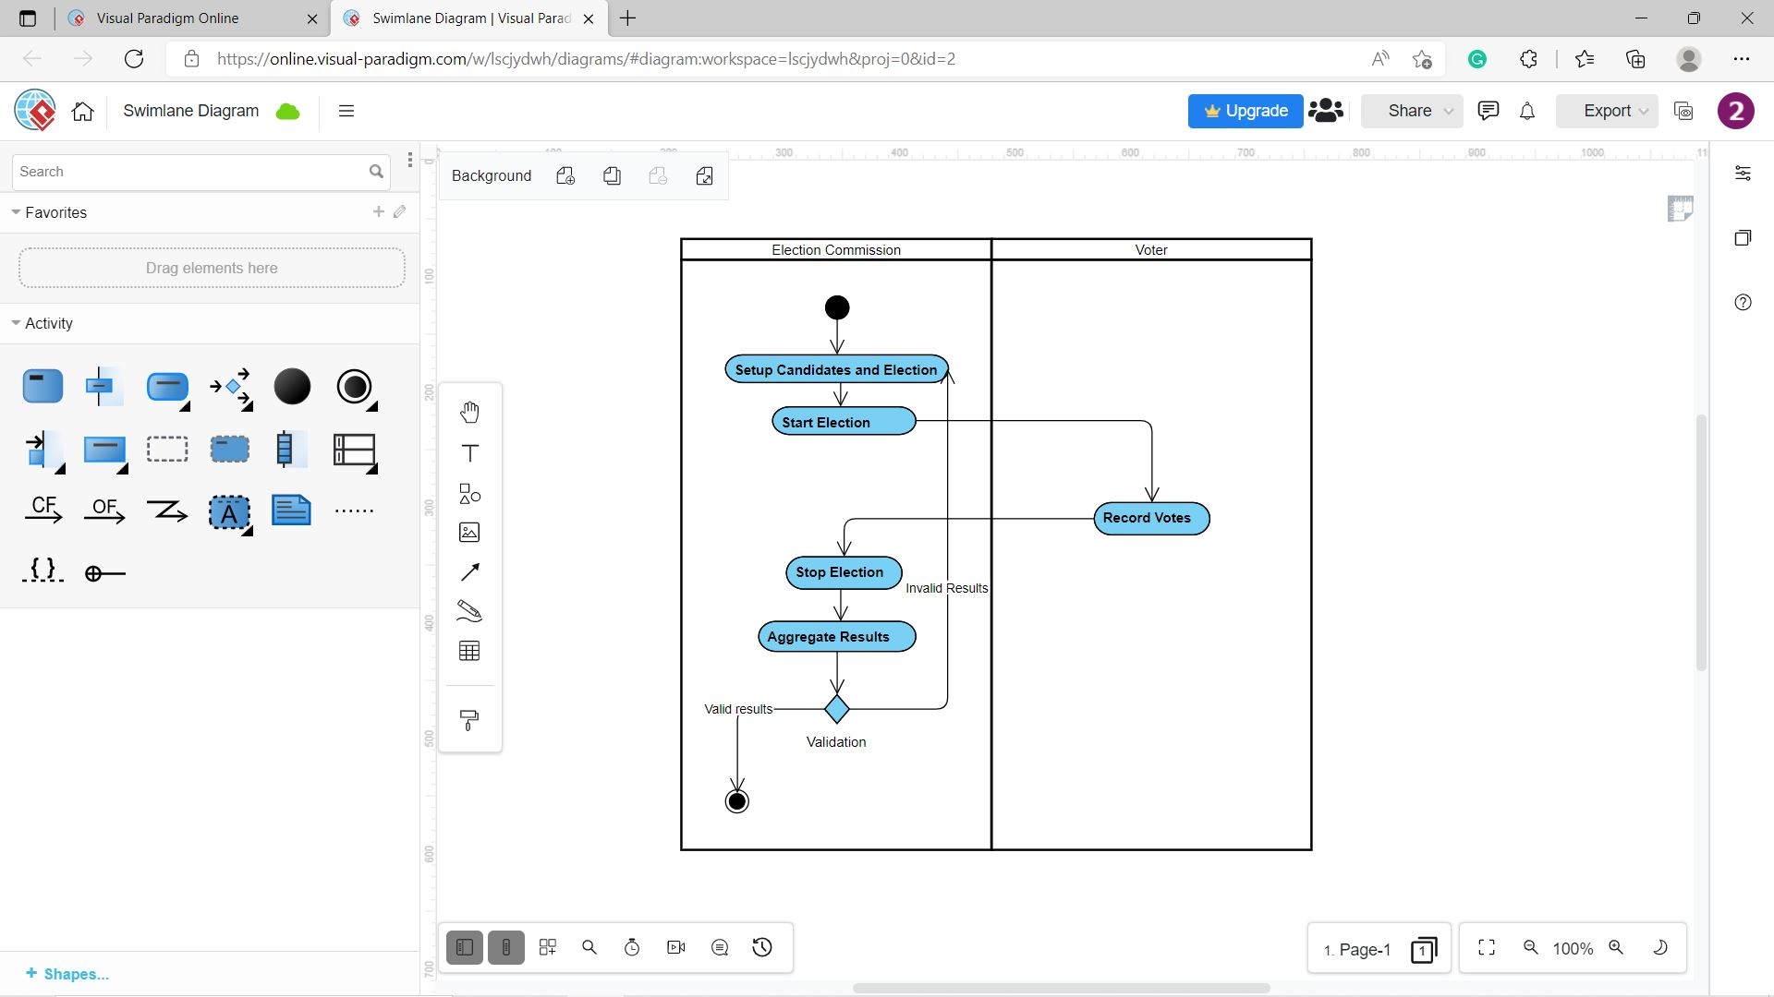
Activity Diagram

Slide 77

Sequence Diagram

Slide 78

Timing Diagram

Slide 79

Interaction Overview Diagram

Slide 80

Thank You

